Slide 1
DOCKERIZE .NET CORE APPLICATIONS

Slide 2
DOCKERIZE .NET CORE APPLICATIONS
Introduction to Docker
Docker Architecture
Docker Installation
Docker CLI
Create Dockerized Application
Create Asp.Net Core Web Application with Docker Configuration

Slide 3

Introduction to Docker
Definition:
Docker is a platform that enables the creation, deployment, and scaling of applications within lightweight, portable containers.
Key Components:
Docker Engine: Core technology responsible for creating and managing containers.
Docker Image: Lightweight, standalone, and executable package that includes application code and dependencies.
Docker Container: An instance of a Docker image, encapsulating the application and its environment.
Containerization Benefits:
Portability: Consistent runtime environment across different systems.
Isolation: Isolates applications, preventing conflicts with the underlying infrastructure.
Resource Efficiency: Efficient utilization of resources, enabling the deployment of multiple containers on a single host.
How Docker Works:
Utilizes containerization technology to package applications and dependencies, ensuring consistency across various environments.
Use Cases:
Microservices Architecture: Facilitates the deployment and scaling of individual microservices.
DevOps Practices: Streamlines the development-to-deployment pipeline, ensuring consistency in different environments.
Docker Compose:
A tool to define and manage multi-container Docker applications, allowing the specification of service dependencies.

Slide 4
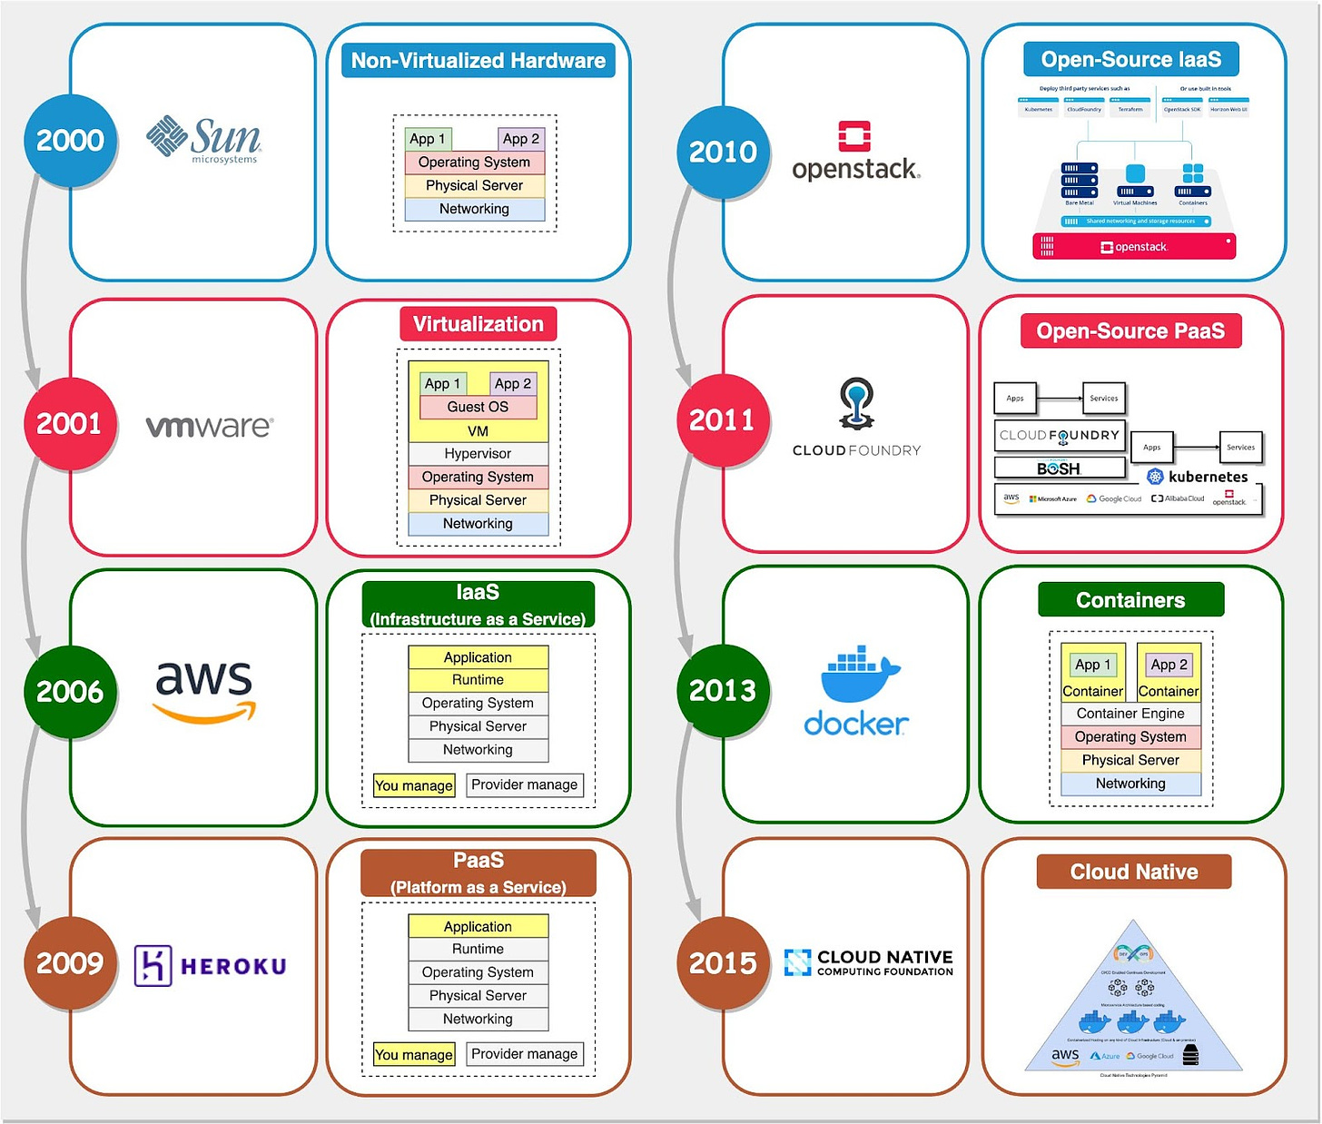
Tracing the Path from Bare Metal to Docker

Slide 5
Why Docker?
Containerization Revolution:
Docker facilitates the containerization of applications, offering numerous advantages in the modern software development landscape.
Portability:
Applications run consistently across different environments, eliminating the "it works on my machine" issue.
Isolation:
Containers encapsulate applications and dependencies, ensuring isolation from the underlying infrastructure, avoiding conflicts.
Resource Efficiency:
Efficient utilization of resources enables running multiple containers on a single host, optimizing resource allocation.
Rapid Deployment:
Streamlines the deployment process, reducing the time and effort needed to get applications up and running.
Microservices Architecture:
Ideal for microservices-based applications, allowing for the independent deployment and scaling of individual services.
DevOps Integration:
Fits seamlessly into DevOps practices, facilitating continuous integration, delivery, and deployment.

Slide 6
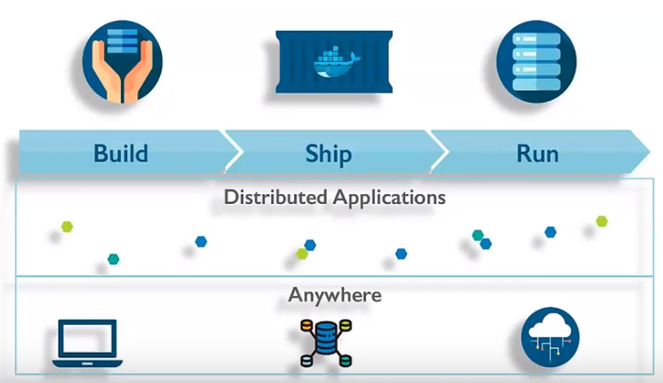
Docker Principles
Docker principle: Build, ship, and run.
Build process: Create a Docker file specifying libraries, commands, etc., for the application.
Ship: Docker file is added to the application, creating Docker images.
Containers: Images stored in Docker containers, allowing direct execution.
Running containers: Images can be executed without additional support.
Docker Hub: Repositories for pushing and pulling images, enabling portability.

Slide 7
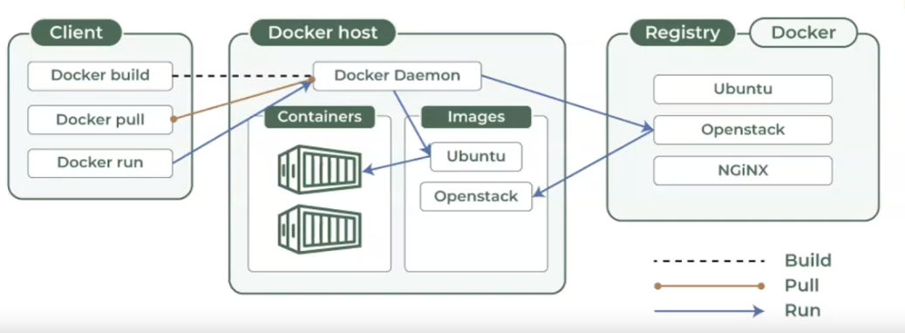
Docker Architecture
Notes:
Docker Architecture Overview:
Client-server architecture.
Docker client communicates with the Docker daemon.
Docker client and daemon can be on the same system or connected remotely.
Communication via REST API over Unix socket or network.
Docker Daemon:
Manages services, communicates with other daemons.
Handles Docker objects (images, containers, volumes) using Docker API requests.
Docker Client:
Interacts with Docker using commands like build, pull, run.
Communicates with multiple daemons.
Sends instructions to the daemon via commands and REST API requests.
Responsible for instructing the Docker host to run containers.
Docker Registry:
Docker images stored in the registry.
Public registry (Docker Hub) and private registry options.
Commands like Docker pull and Docker push interact with the registry.
Docker Storage:
Uses active storage.
Data stored in the writable layer of the container.
Requires a storage layer.
Common Commands:
Docker run, Docker pull, Docker build used by Docker clients.
Docker Images:
Stored in Docker registry.
Docker run and Docker pull commands fetch and pull images.
Docker push command pushes images to the registry.

Slide 8
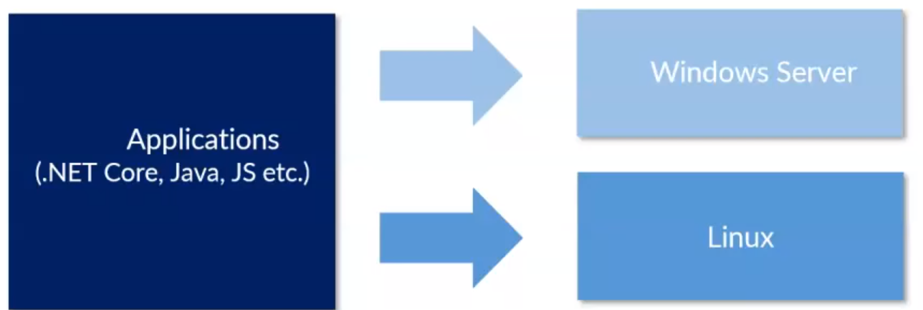
Docker for Developer
Docker Overview:
Powerful open-source platform for developing and deploying applications.
Automates deployment by using containers.
Application Support:
Supports various languages such as .NET Core, Java, JavaScript, Python.
Lightweight and Fast:
Designed to provide a lightweight and fast environment for running code.
Efficient Workflow:
Facilitates a streamlined workflow for code deployment.
Moves code from the development laptop to the test environment and then to production.
Cross-Platform Deployment:
Allows deployment onto Windows Server or Linux kernels.
Utilizes containers for consistency in deployment environments.
Docker for Developers:
Creates reproducible environments.
Features: open source, lightweight, efficient, secure, scalable.
Manages image, networking, and volume.
Enables packaging code into container images for distribution.
Core Principle: Ship, deploy, run.
Ensures consistent application execution across environments.
Supports running different versions of applications.
Adaptable to various technologies.

Slide 9
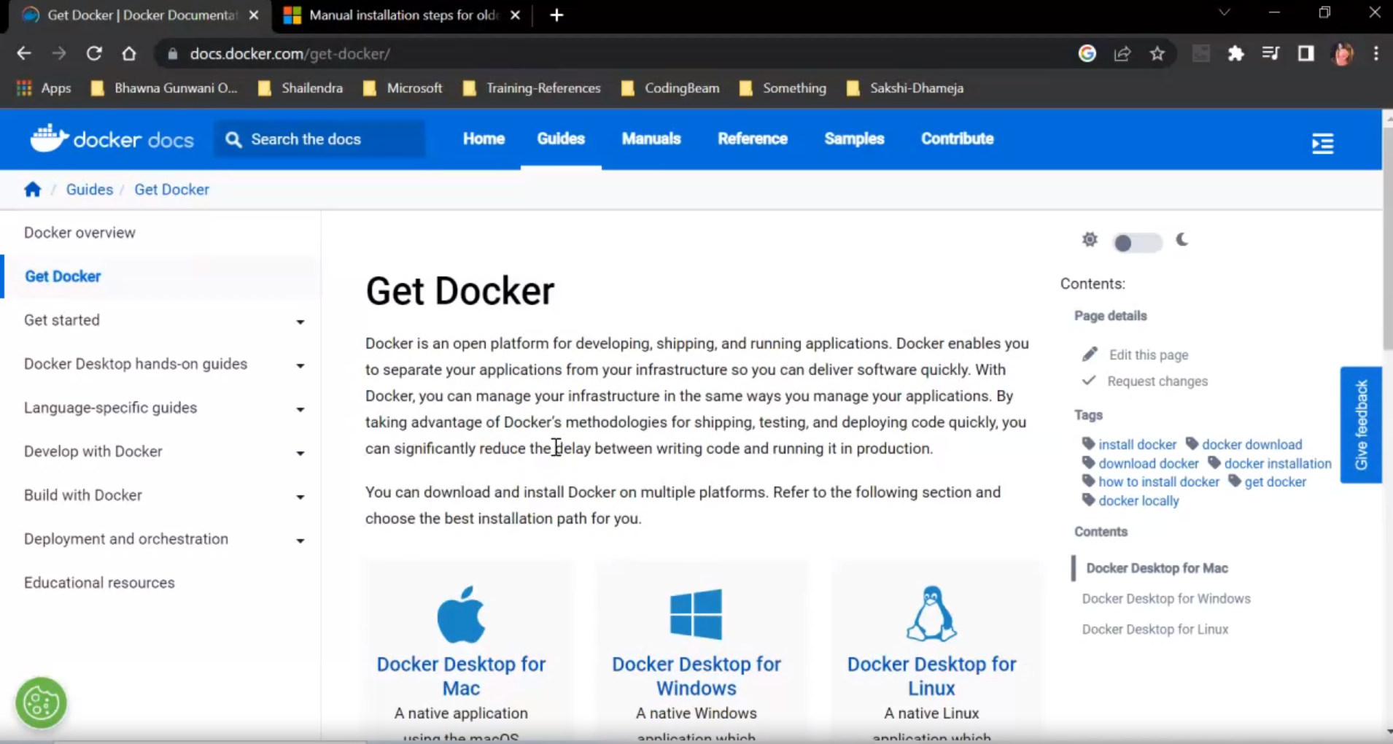
Get Docker from the Official Website

Slide 10
Enable WSL2

Slide 11
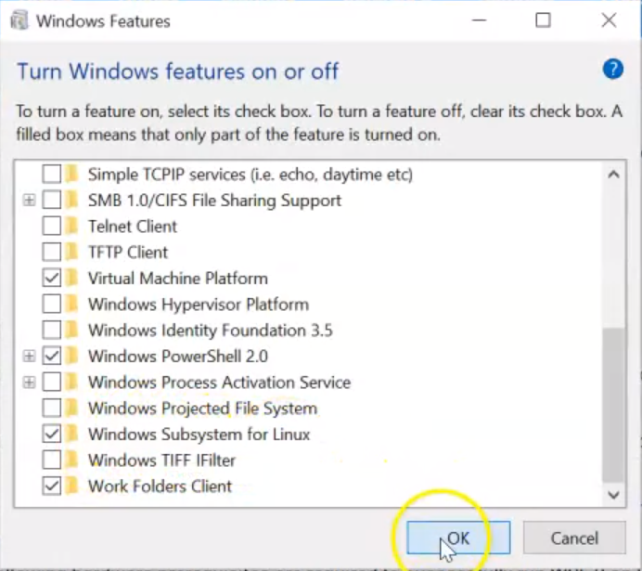
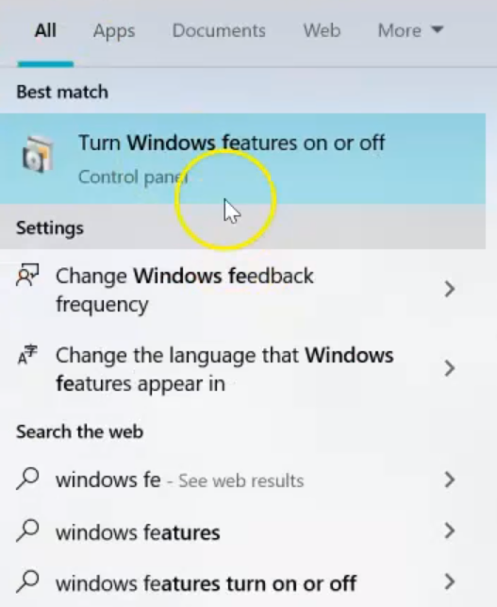
Enable WSL2

Slide 12
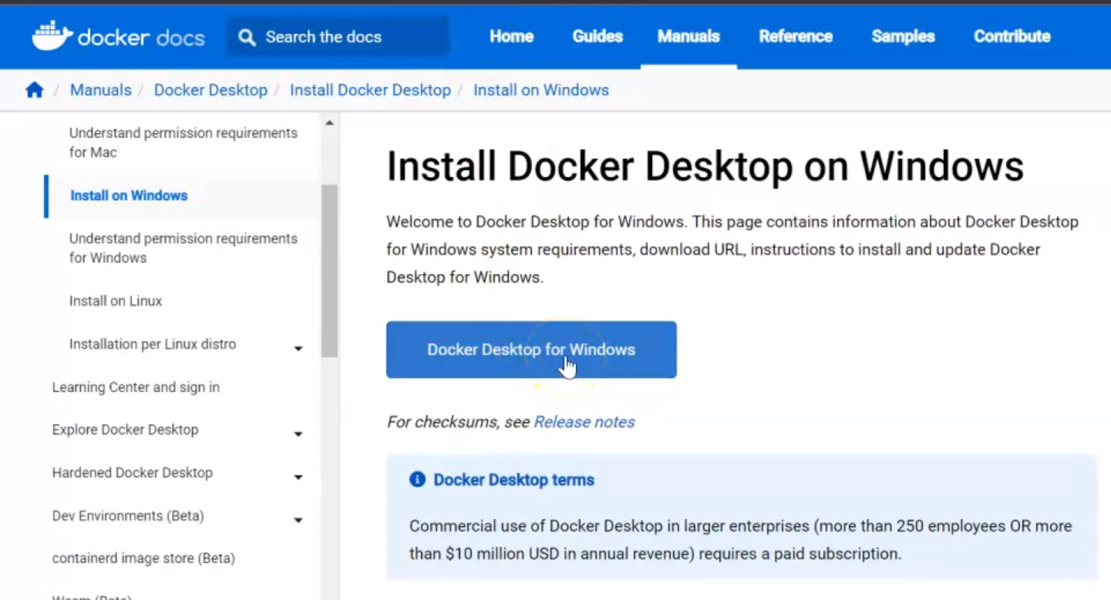
Install Docker Desktop on Windows

Slide 13
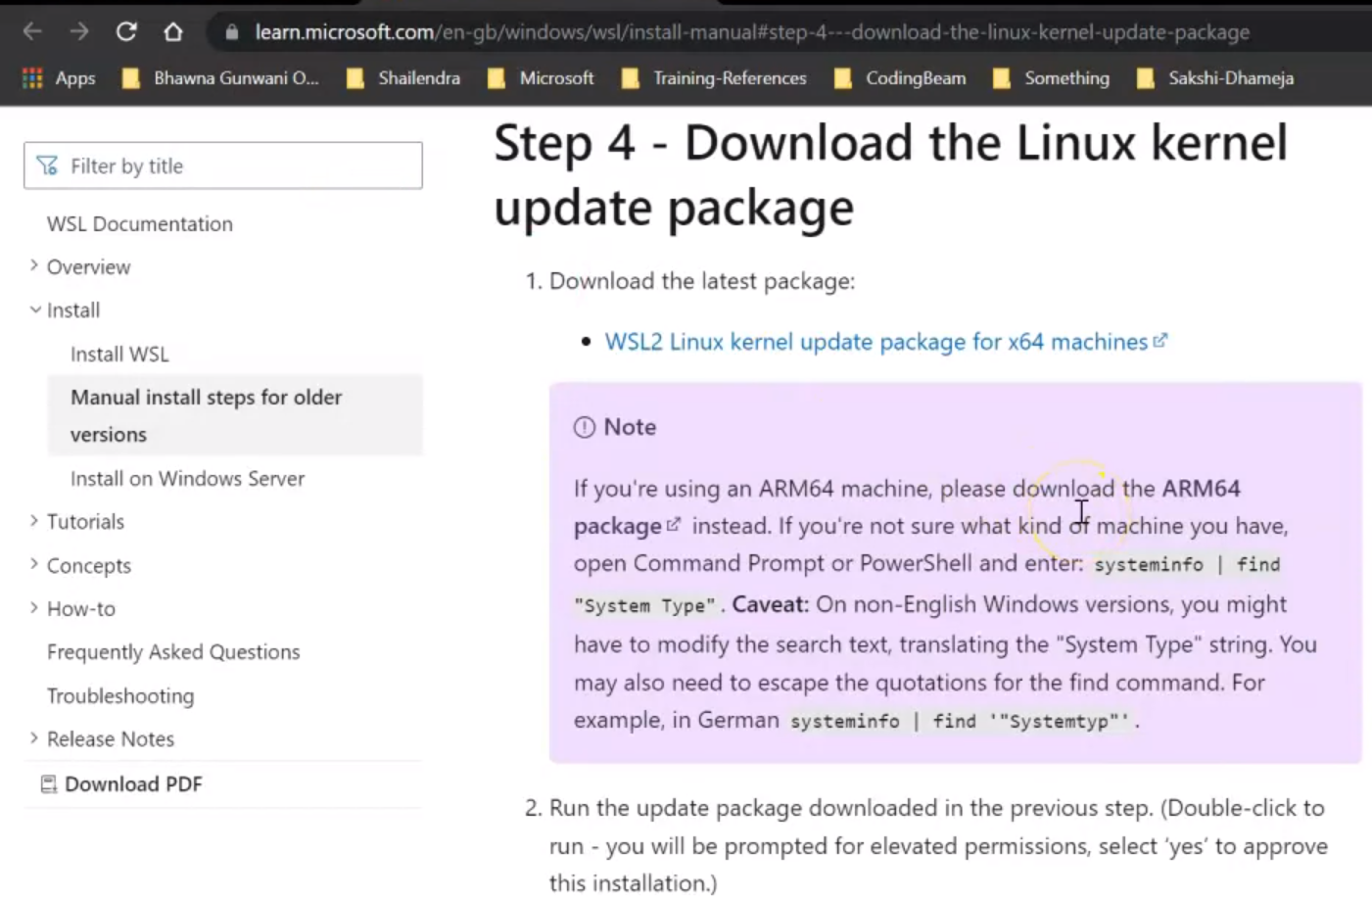
Install the Package if needed

Slide 14
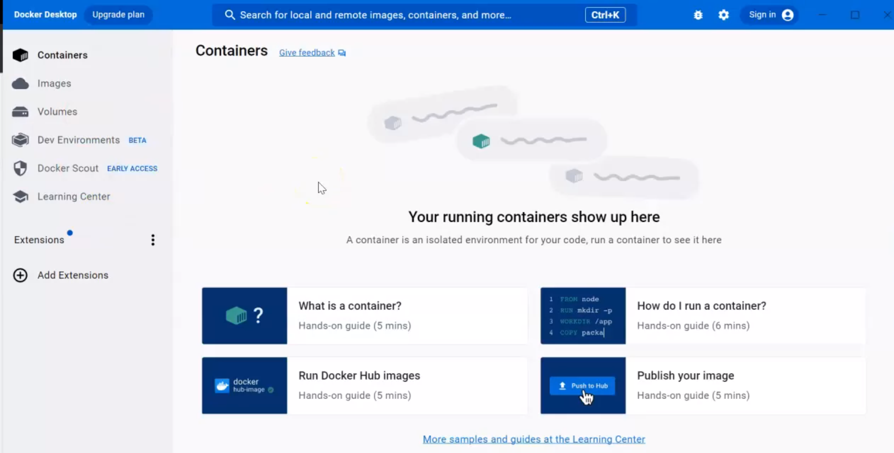
Docker Desktop

Slide 15
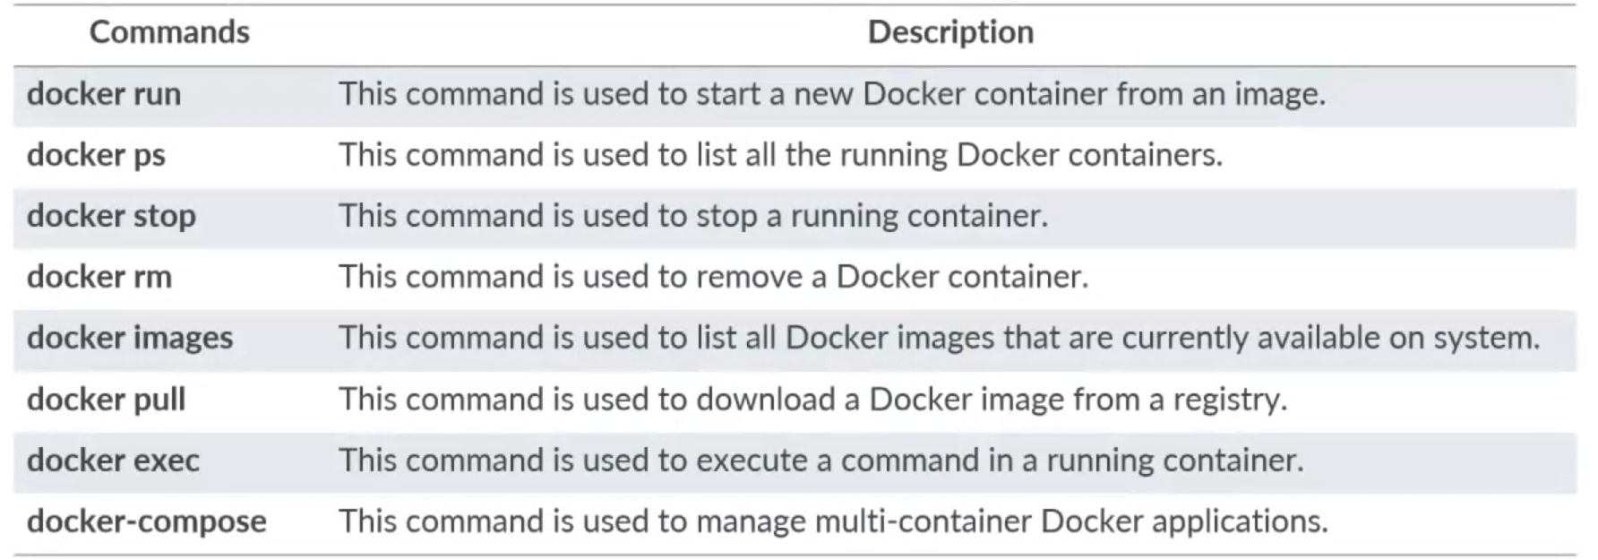
DOCKER CLI COMMANDS

Slide 16
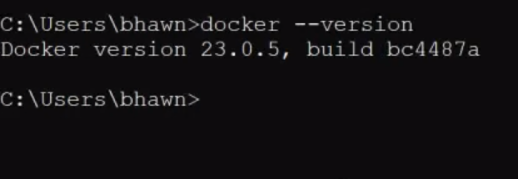
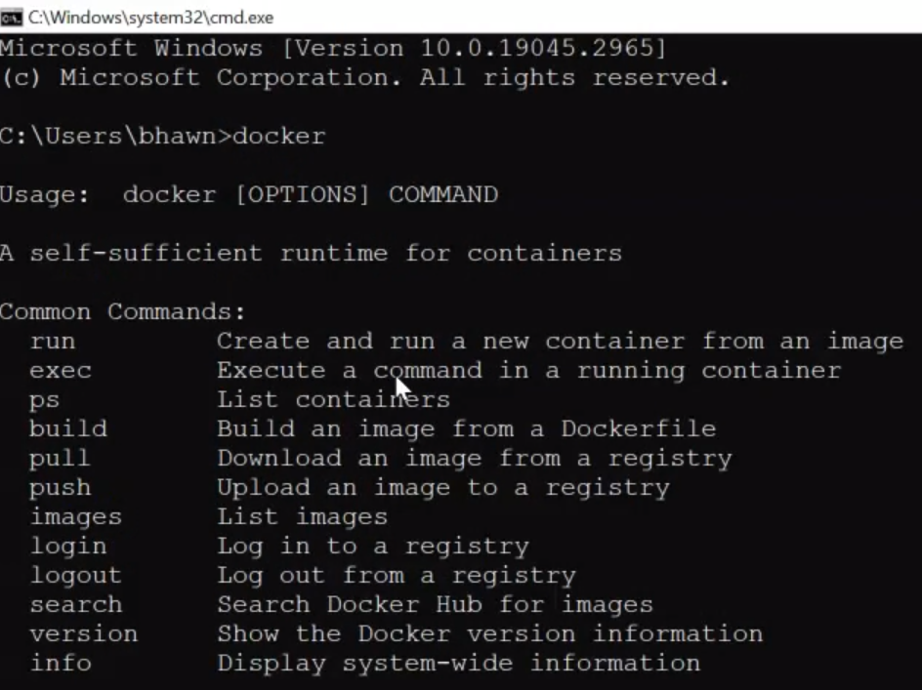
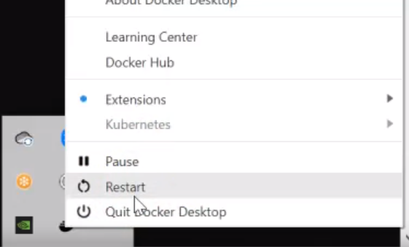
Docker Commands
Check Version
Restart Docker if needed

Slide 17
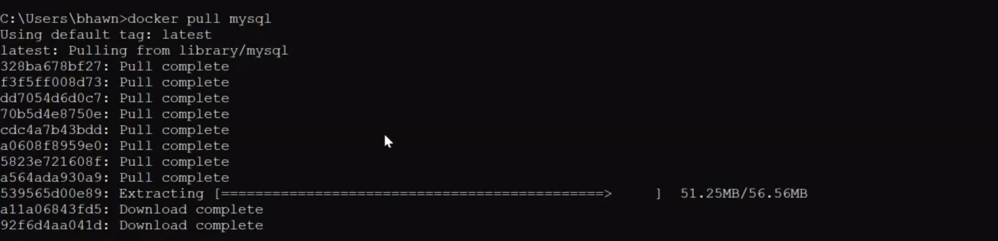
Docker Command
Check Current images
Check Running Docker
Pull MySQL Docker image

Slide 18
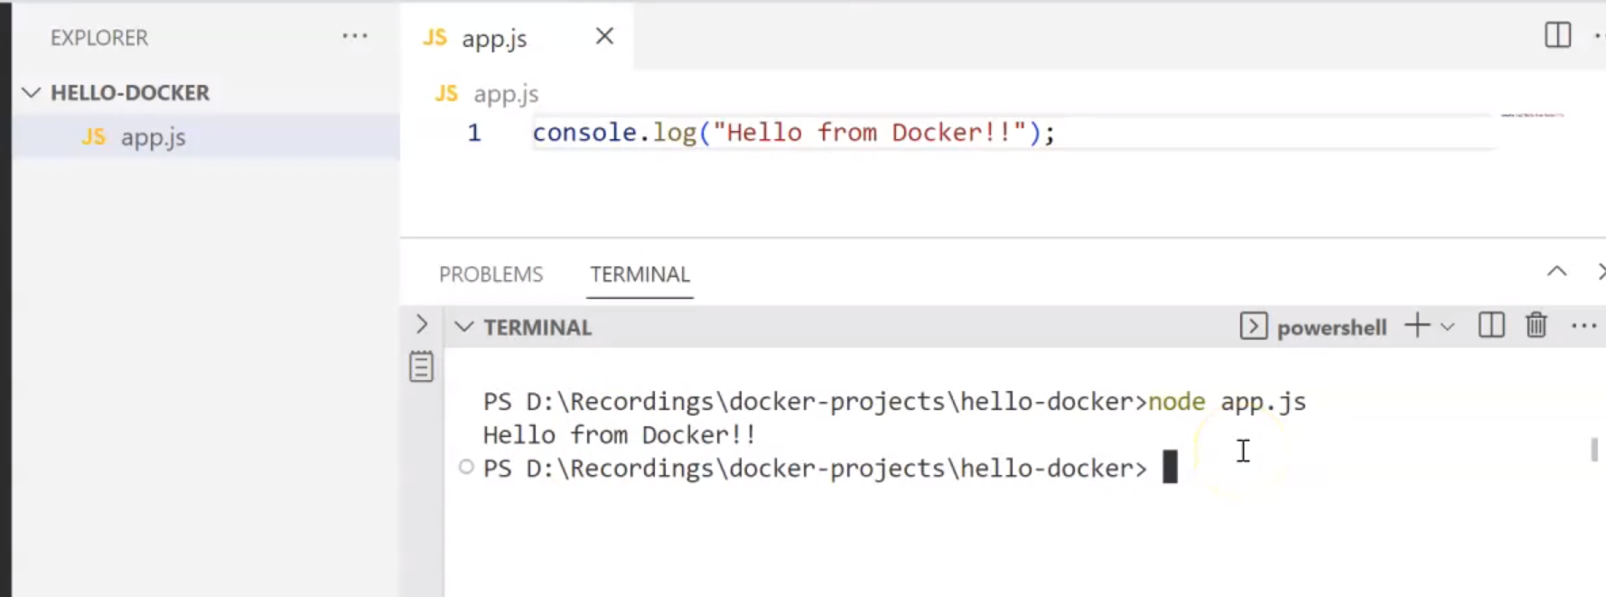
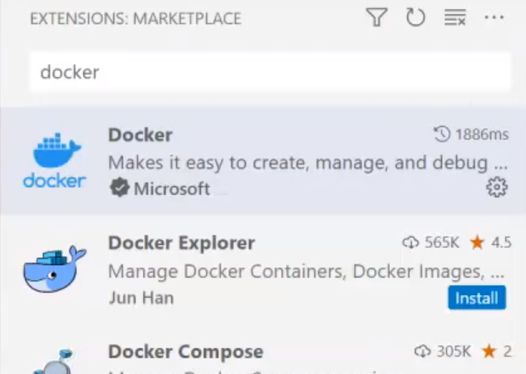
Create Dockerized Application
Create basic Node app.js file
Install the Extension

Slide 19
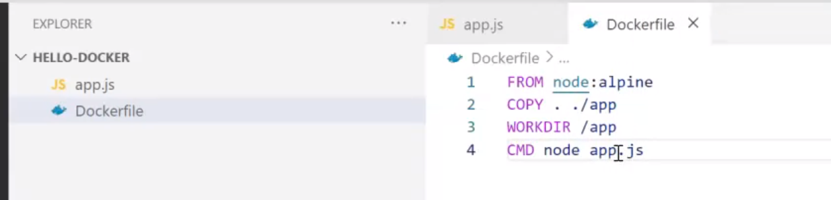
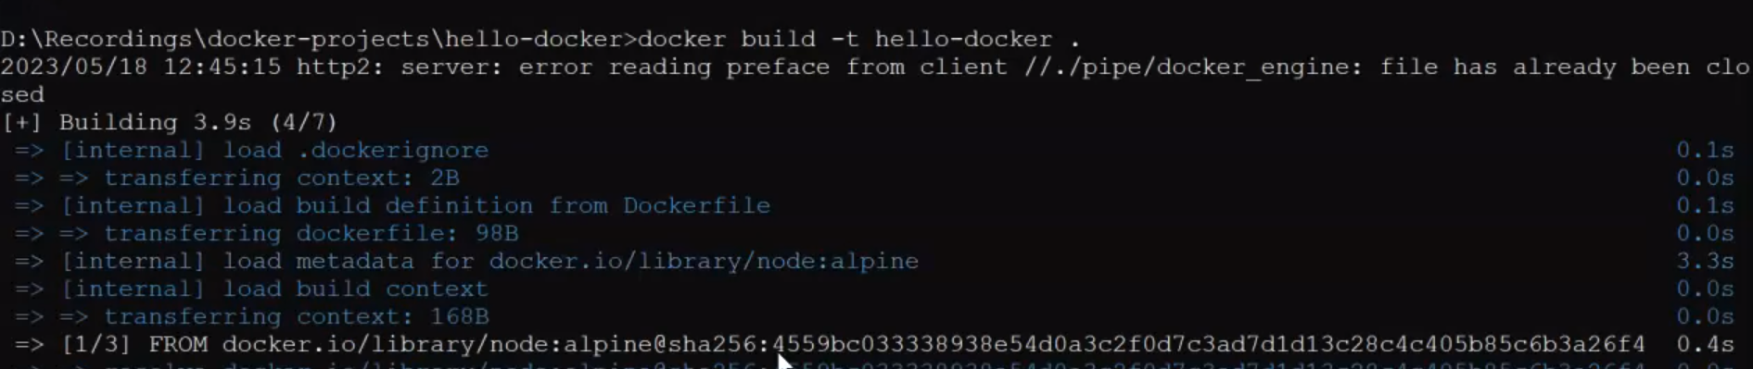
Create Dockerized Application
Create the Dockerfile
Build the Docker image

Slide 20
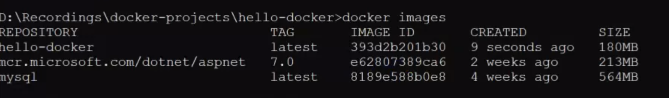
Create Dockerized Application
The Image is available
Run the image

Slide 21
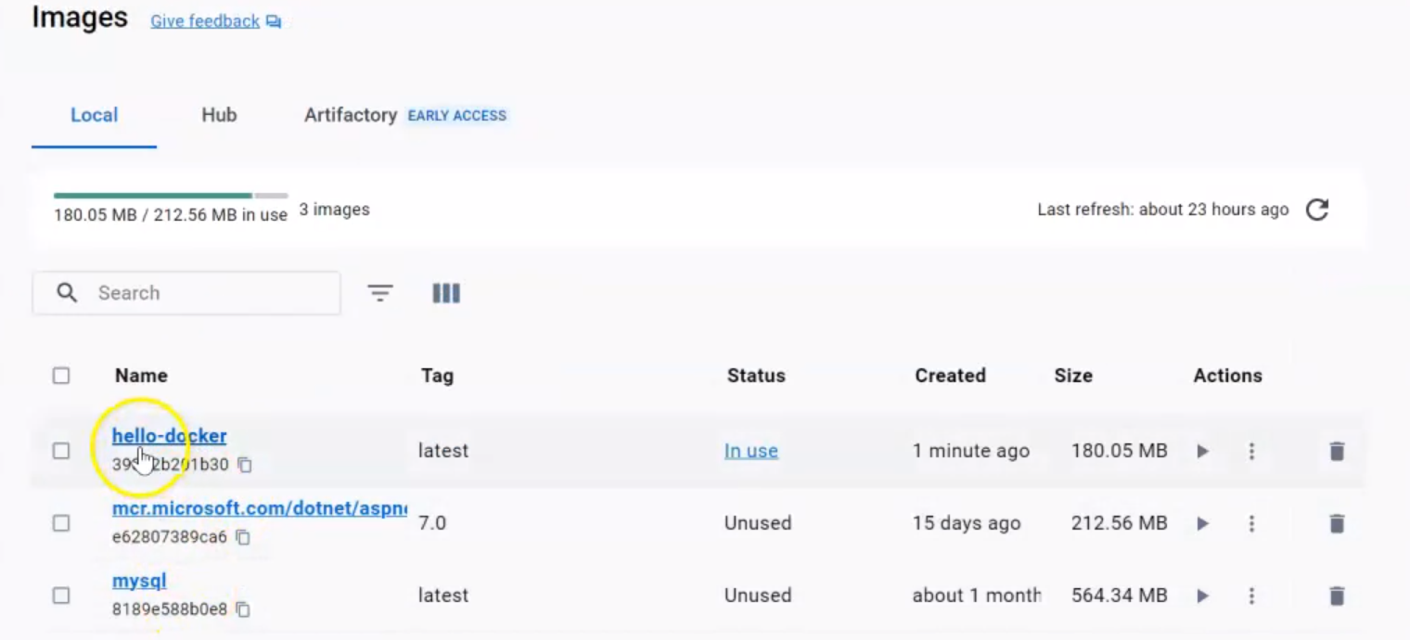
Create Dockerized Application
The Image can be seen in the Docker Desktop

Slide 22
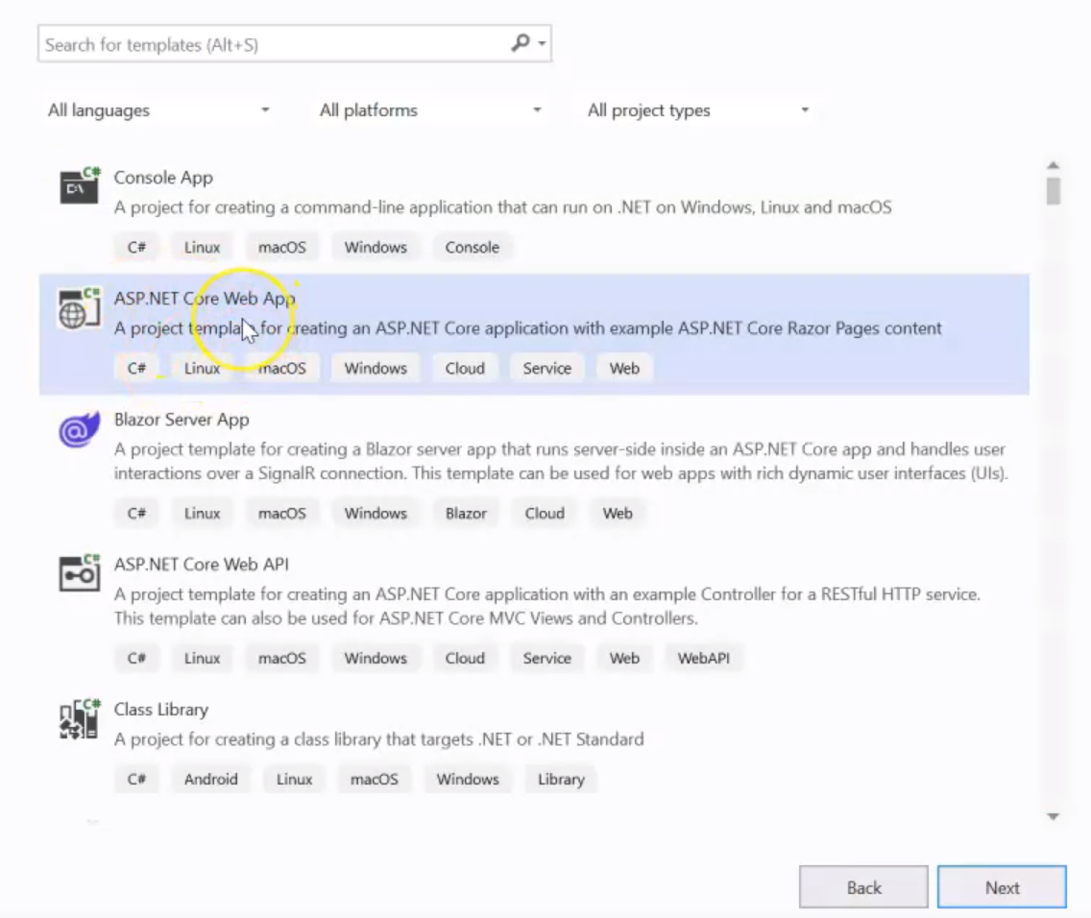
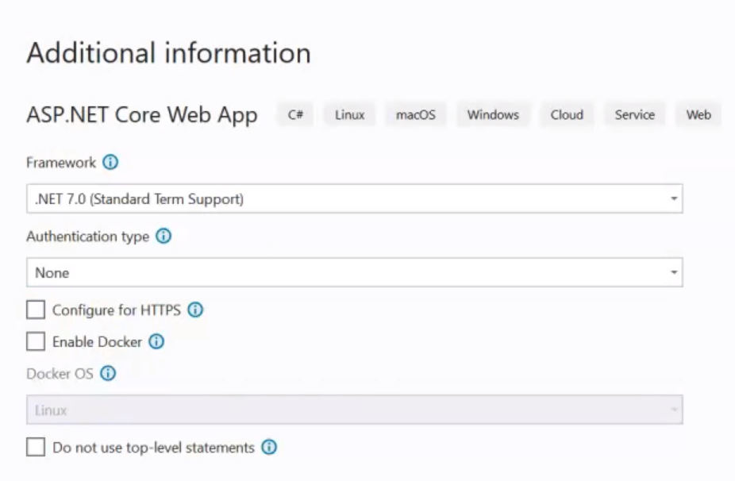
Create Asp.Net Core Web Application with Docker Configuration

Slide 23
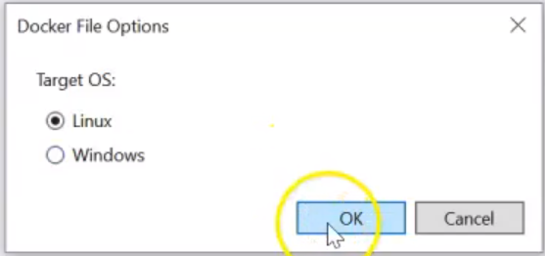
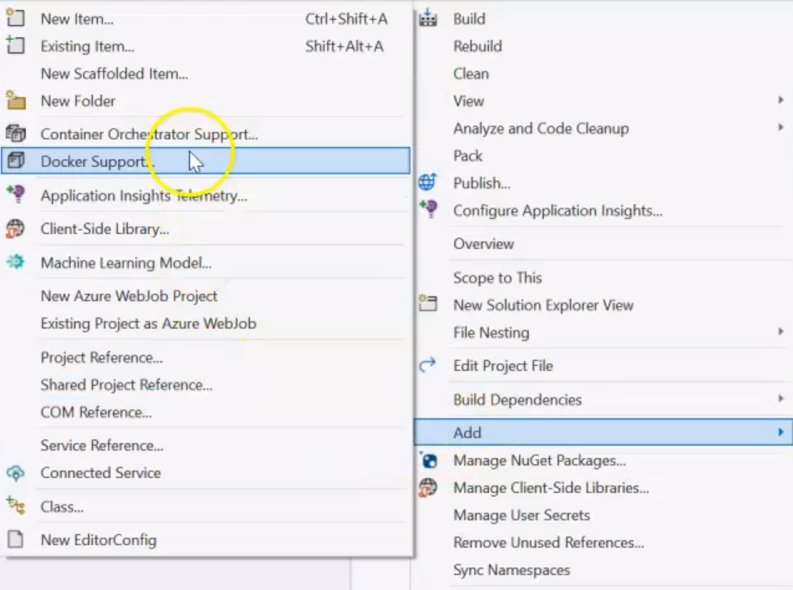
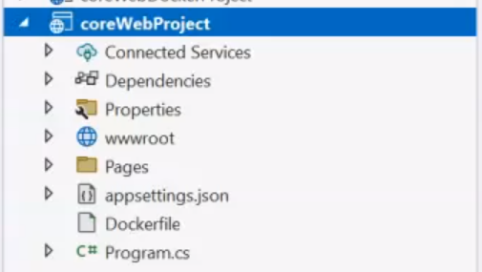
Create Asp.Net Core Web Application with Docker Configuration

Slide 24
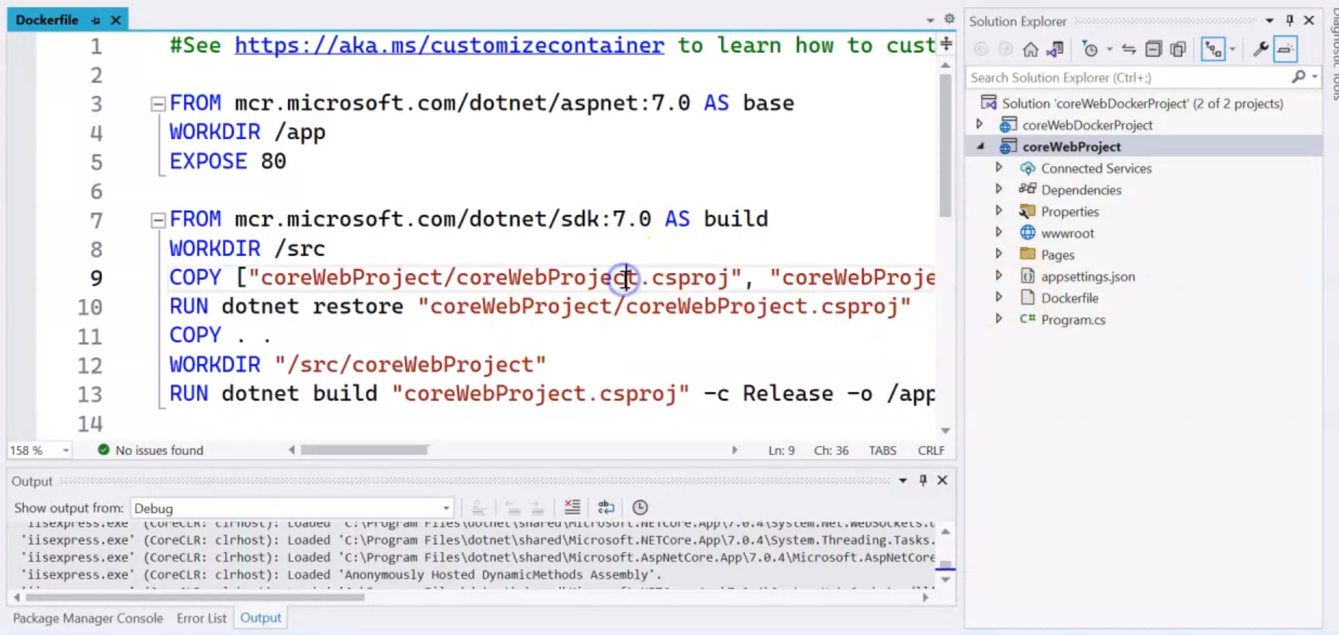
Create Asp.Net Core Web Application with Docker Configuration

Slide 25
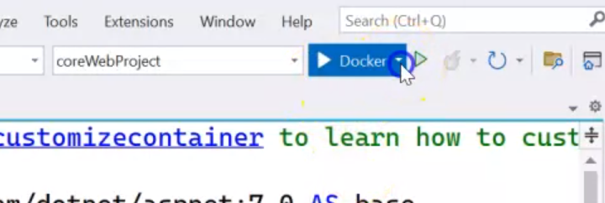
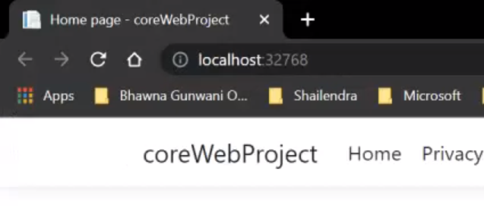
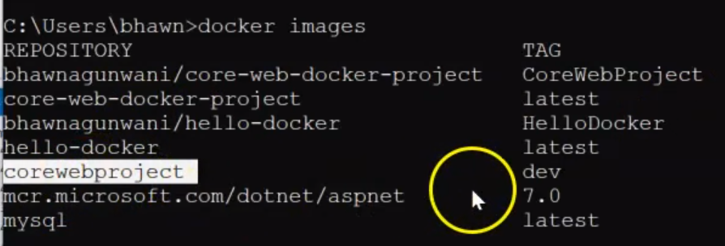
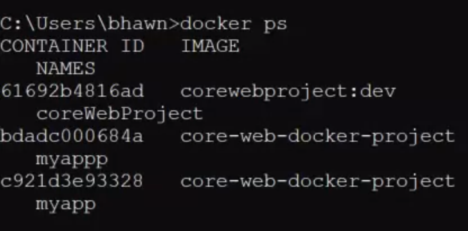
Create Asp.Net Core Web Application with Docker Configuration
Application runs successfully
The Docker is running
The docker image is up

Slide 26
Q&A

